Slide 1


HTML Forms
Presented by: Hau Nguyen
Notes:
Get connected
Self introduction
Engagement questions
Will have gifts if you can answer questions
——
How many of you didn’t know HTML/CSS before?
How many of you already know HTML/CSS?
How many of you never heard about HTML/CSS?

Slide 2
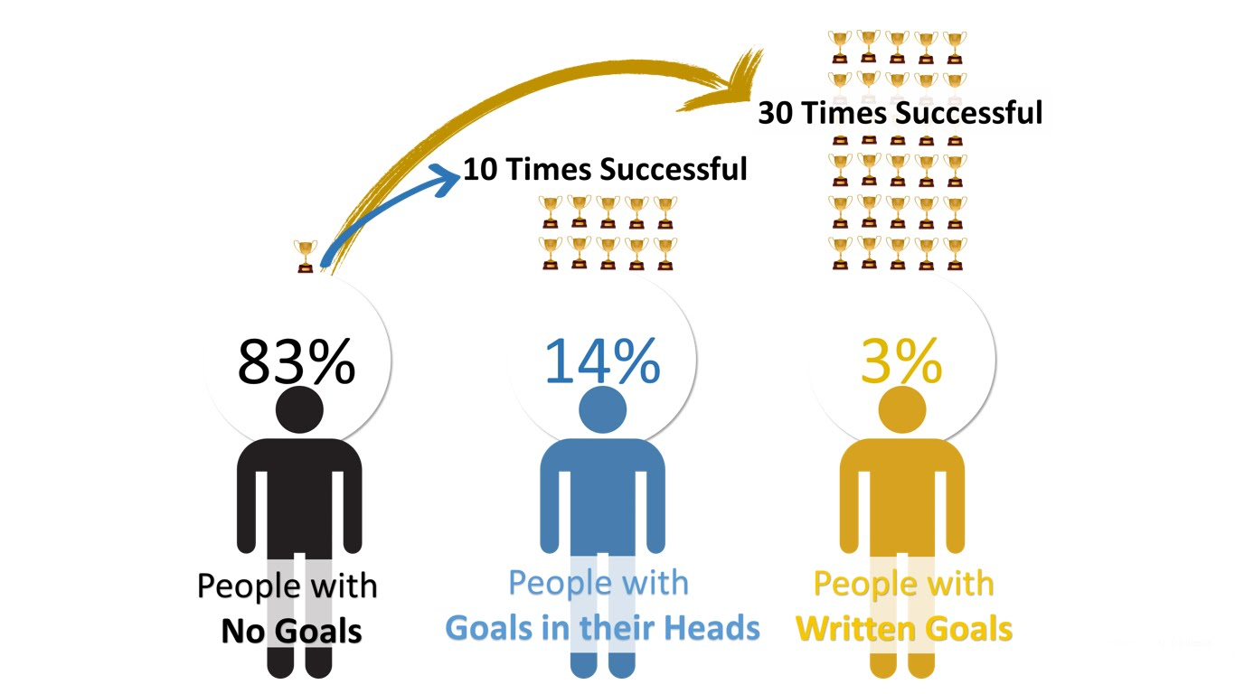
Anyone achieve your goal yet?
https://financesonline.com/tips-writing-goals-increase-productivity-work/

Slide 3
Agenda
HTML Forms
Input, Select, Submit
Styling form elements
Q & A

Slide 4
HTML Forms

Slide 5
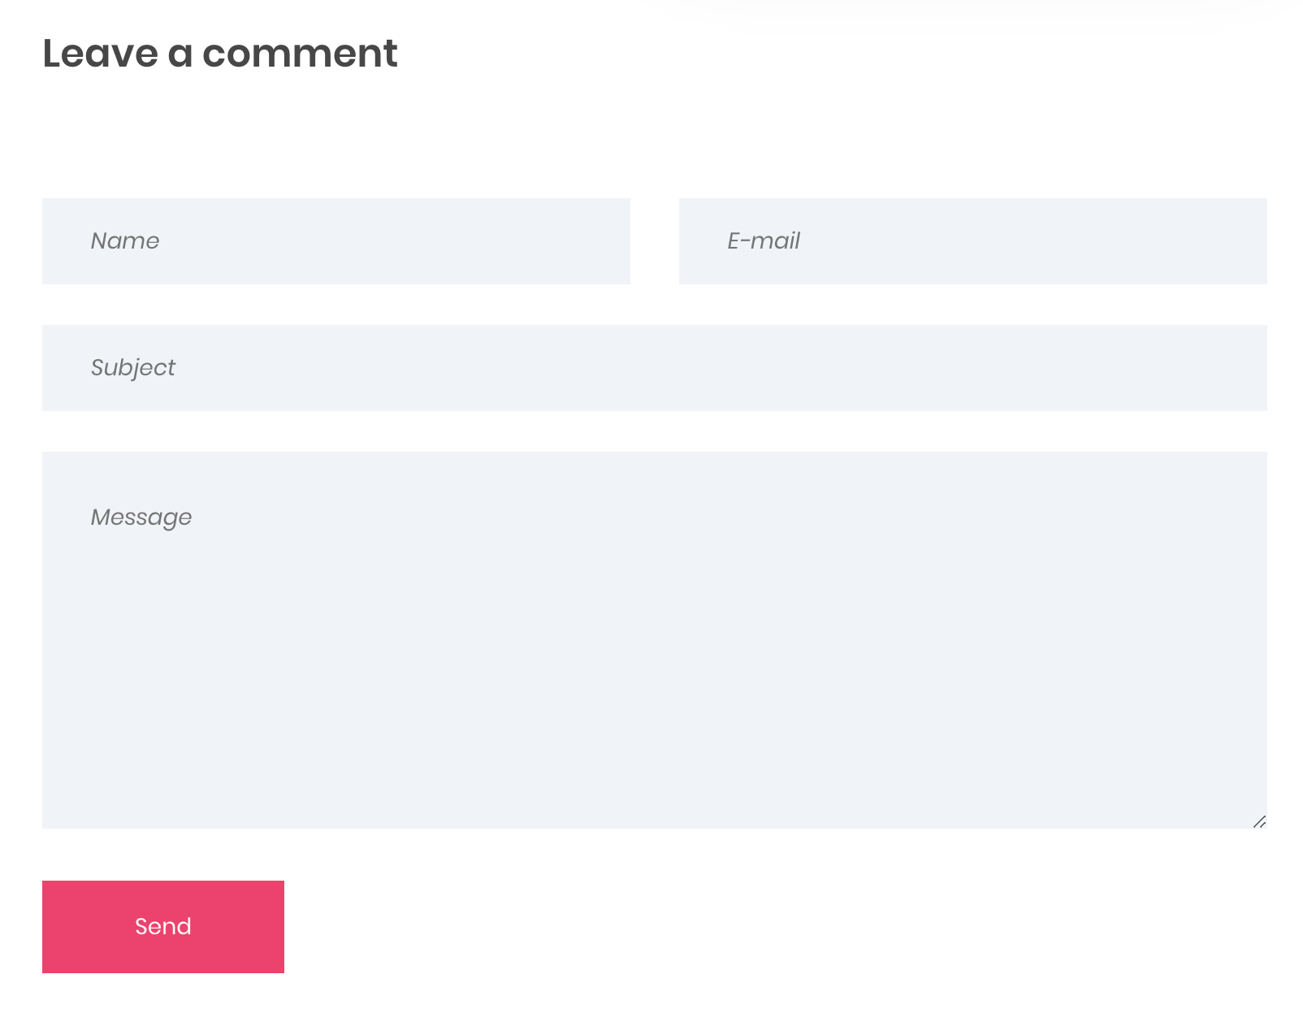
Sample form

Slide 6
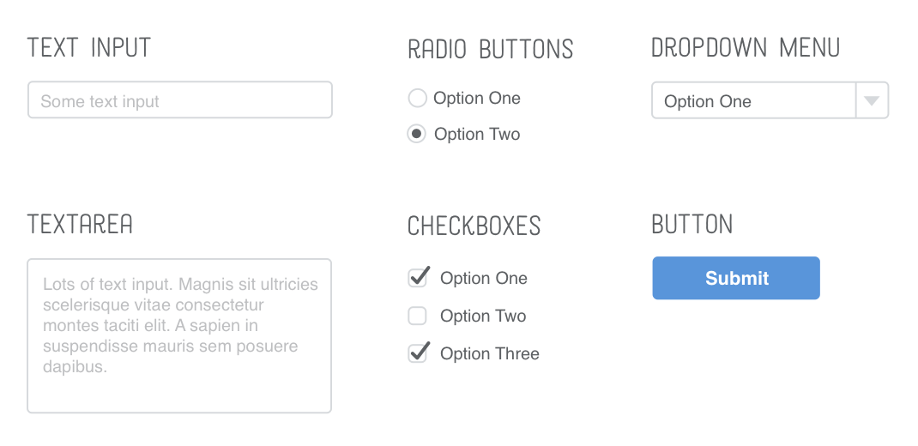
Form elements

Slide 7


Slide 8

Thank You And see you ;)

